Slide 1
Unit 3
Server Concepts:
WEB Proxy, RADIUS, MAIL

Slide 2
What is Server?
a computer or computer program which manages access to a centralized resource or service in a network
A server is a running instance of an application (software) capable of accepting requests from the client and giving responses accordingly.
Servers can run on any computer including dedicated computers, which individually are also often referred to as "the server“
Servers operate within a client-server architecture.
Servers are computer programs running to serve the requests of other programs, the clients.
Thus, the server performs some tasks on behalf of clients. It facilitates the clients to share data, information or any hardware and software resources.
The clients typically connect to the server through the network but may run on the same computer. In the context of Internet Protocol (IP) networking, a server is a program that operates as a socket listener
Servers often provide essential services across a network, either to private users inside a large organization or to public users via the Internet

Slide 3
Types of servers may be found in world wide web.
Application server:- a server dedicated to running certain software applications
Catalog server :- a central search point for information across a distributed network
Communication :- server, carrier-grade computing platform for communications networks
Compute server :- a server intended for intensive (esp. scientific) computations
Database server :- provides database services to other computer programs or computers
Fax server, :- provides fax services for clients
File server :- provides remote access to files
Game server :- a server that video game clients connect to in order to play online together
Mail server :- handles transport of and access to email
Media server :- a specialized application server, usually enterprise class machine, providing video on demand
Mobile Server, :- or Server on the Go is an Intel Xeon processor based server class laptop form factor computer.
Name server or DNS
Print server :- provides printer services
Proxy server, :- acts as an intermediary for requests from clients seeking resources from other servers
Sound server :- provides multimedia broadcasting, streaming.
Web server :- a server that HTTP clients connect to in order to send commands and receive responses along with data contents

Slide 4
Web Server:
Web server can refer to either the hardware (the computer) or the software (the computer application) that helps to deliver Web content that can be accessed through the Internet.
The most common use of web servers is to host websites, but there are other uses such as gaming, data storage or running enterprise applications.
The primary function of a web server is to deliver web pages on the request to clients using the Hypertext Transfer Protocol (HTTP).
This means delivery of HTML documents and any additional content that may be included by a document, such as images, style sheets and scripts.
A user agent, commonly a web browser or web crawler, initiates communication by making a request for a specific resource using HTTP and the server responds with the content of that resource or an error message if unable to do so.
The resource is typically a real file on the server's secondary memory, but this is not necessarily the case and depends on how the web server is implemented.

Slide 5
Contd…
While the primary function is to serve content, a full implementation of HTTP also includes ways of receiving content from clients. This feature is used for submitting web forms, including uploading of files.
Many generic web servers also support server-side scripting using Active Server Pages (ASP), PHP, or other scripting languages.
This means that the behavior of the web server can be scripted in separate files, while the actual server software remains unchanged. Usually, this function is used to create HTML documents dynamically ("on-the-fly") as opposed to returning static documents.
The former is primarily used for retrieving and/or modifying information from databases.
The latter is typically much faster and more easily cached. Web servers are not always used for serving the World Wide Web.
A web server (program) has defined load limits, because it can handle only a limited number of concurrent client connections (usually between 2 and 80,000, by default between 500 and 1,000) per IP address (and TCP port) and it can serve only a certain maximum number of requests per second depending on its own settings, the HTTP request type, whether the content is static or dynamic, whether the content is cached, and the hardware and software limitations of the OS of the computer on which the web server runs.

Slide 6
At any time web servers can be overloaded because of:
Too much legitimate web traffic. Thousands or even millions of clients connecting to the web site in a short interval, e.g., Slashdot effect; the term "Slashdot effect" refers to phenomenon of a website becoming virtually unreachable because too many people are hitting it after the site was mentioned in an interesting article on the popular Slashdot news service.
Distributed Denial of Service attacks. A denial-of-service attack (DoS attack) or distributed denial-of-service attack (DoS attack) is an attempt to make a computer or network resource unavailable to its intended users;
Computer worms that sometimes cause abnormal traffic because of millions of infected computers (not coordinated among them);
XSS viruses can cause high traffic because of millions of infected browsers and/or web servers;
Internet bots. Traffic not filtered/limited on large web sites with very few resources (bandwidth, etc.);
Internet (network) slowdowns, so that client requests are served more slowly and the number of connections increases so much that server limits are reached;
Web servers (computers) partial unavailability. This can happen because of required or urgent maintenance or upgrade, hardware or software failures, back-end (e.g., database) failures, etc.; in these cases the remaining web servers get too much traffic and become overloaded.

Slide 7
Proxy Server
A proxy server is computer that functions as an intermediary between a web browser (such as Internet Explorer) and the Internet. Proxy servers help improve web performance by storing a copy of frequently used web pages
proxy server is a server (a computer system or an application) that acts as an intermediary for requests from clients seeking resources from other servers.
A client connects to the proxy server, requesting some service, such as a file, connection, web page, or other resource available from a different server and the proxy server evaluates the request as a way to simplify and control its complexity.
Proxies were invented to add structure and encapsulation to distributed systems.
Today, most proxies are web proxies, facilitating access to content on the World Wide Web and providing anonymity

Slide 8
What is a Web Proxy Server?
It is a specialized HTTP Server.
Functions as a firewall.
Protects client computers from Hackers by limiting outside access to clients.
Allows all clients connected to Web Proxy Server to access Internet from behind “firewall.”
Client computer(s) are allowed access past firewall with minimum effort and without compromising security.

Slide 9
How Does A Web Proxy Server Work?
Web Proxy Server listens for any request from clients.
All requests are forwarded to remote internet servers outside firewall.
Also listens for responses or request from outside the firewall (external servers) and sends to them to internal client computers.

Slide 10
Contd..
Usually, all clients with a subnet use the same proxy server.
This makes it possible for the proxy server to cache documents that are requested by one or more clients (repeatedly).
For clients using a web proxy server, it is as if they are getting responses directly from a remote server.

Slide 11
Contd…
Clients without a Domain Name Service can still access the Web
All that is needed is the proxy server’s IP address.
Most Web Proxy Servers are implemented on a per-access method basis.
It can allow or deny internet requests according to the protocol used.
For Example: A proxy server can allow calls to FTP while but deny calls to HTTP servers.

Slide 12
purposes of proxy server
To keep machines behind it anonymous, mainly for security.
To speed up access to resources (using caching). Web proxies are commonly used to cache web pages from a web server.
To apply access policy to network services or content, e.g. to block undesired sites.
To access sites prohibited or filtered by your ISP or institution.
To log / audit usage, i.e. to provide company employee Internet usage reporting.
To bypass security / parental controls.
To circumvent Internet filtering to access content otherwise blocked by governments.
To scan transmitted content for malware before delivery.
To scan outbound content, e.g., for data loss prevention.
To allow a web site to make web requests to externally hosted resources (e.g. images, music files, etc.) when cross-domain restrictions prohibit the web site from linking directly to the outside domains.

Slide 13
Types of proxy
A proxy server may reside on the user's local computer, or at various points between the user's computer and destination servers on the Internet.
A proxy server that passes requests and responses unmodified is usually called a gateway or sometimes a tunneling proxy.
A forward proxy is an Internet-facing proxy used to retrieve from a wide range of sources (in most cases anywhere on the Internet).
A reverse proxy is usually an Internet-facing proxy used as a front-end to control and protect access to a server on a private network. A reverse proxy commonly also performs tasks such as load-balancing, authentication, decryption or caching.

Slide 14
Open proxies
An open proxy is a forwarding proxy server that is accessible by any Internet user.
Gordon Lyon estimates there are "hundreds of thousands" of open proxies on the Internet.
An anonymous open proxy allows users to conceal their IP address while browsing the Web or using other Internet services.
There are varying degrees of anonymity however, as well as a number of methods of 'tricking' the client into revealing itself regardless of the proxy being used

Slide 15
Reverse proxies
A reverse proxy (or surrogate) is a proxy server that appears to clients to be an ordinary server.
Requests are forwarded to one or more proxy servers which handle the request.
The response from the proxy server is returned as if it came directly from the origin server, leaving the client no knowledge of the origin servers.
Reverse proxies are installed in the neighborhood of one or more web servers.
All traffic coming from the Internet and with a destination of one of the neighborhood's web servers goes through the proxy server. The use of "reverse" originates in its counterpart "forward proxy" since the reverse proxy sits closer to the web server and serves only a restricted set of websites

Slide 16
Reasons for installing reverse proxy servers
Encryption / SSL acceleration: when secure web sites are created, the SSL encryption is often not done by the web server itself, but by a reverse proxy that is equipped with SSL acceleration hardware. Furthermore, a host can provide a single "SSL proxy" to provide SSL encryption for an arbitrary number of hosts; removing the need for a separate SSL Server Certificate for each host, with the downside that all hosts behind the SSL proxy have to share a common DNS name or IP address for SSL connections.
Load balancing: the reverse proxy can distribute the load to several web servers, each web server serving its own application area. In such a case, the reverse proxy may need to rewrite the URLs in each web page
Serve/cache static content: A reverse proxy can offload the web servers by caching static content like pictures and other static graphical content.
Compression: the proxy server can optimize and compress the content to speed up the load time.
Spoon feeding: reduces resource usage caused by slow clients on the web servers by caching the content the web server sent and slowly "spoon feeding" it to the client. This especially benefits dynamically generated pages.
Security: the proxy server is an additional layer of defense and can protect against some OS and Web Server specific attacks. However, it does not provide any protection from attacks against the web application or service itself, which is generally considered the larger threat.
Extranet Publishing: a reverse proxy server facing the Internet can be used to communicate to a firewall server internal to an organization, providing extranet access to some functions while keeping the servers behind the firewalls. If used in this way, security measures should be considered to protect the rest of your infrastructure in case this server is compromised, as its web application is exposed to attack from the Internet.

Slide 17
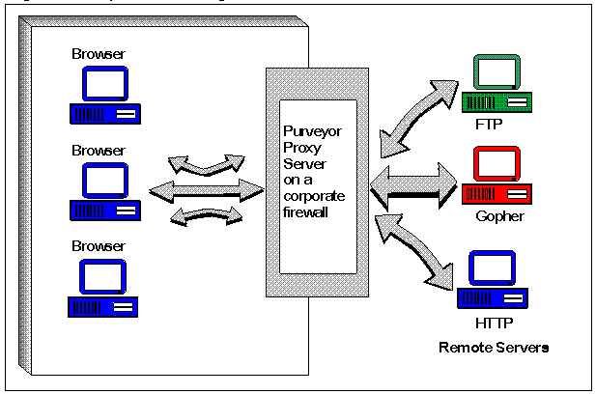

Slide 18
Caching Documents?
Caching documents means keeping a copy of internet documents so the server doesn’t need to request them over again.
It is more effective with the web proxy server than for the client.
Saves disk space because only one copy needs to be cached.
System administrator can also predict which documents are worth caching and which ones are not.

Slide 19
Benefits of Caching With A Web Proxy Server?
Reduces the load on the server itself.
Allows server to get information from the cache when responding to repeated client requests for the same document or data.
Also makes it possible to browse the Web even if the Web Proxy Server or external network is down (as long as clients can connect to proxy server).

Slide 20
Controlling Access to the Internet and Subnets?
Web proxy server makes it possible to filter client “transactions” at the protocol level.
Controls access to services for individual methods, hosts, as well as domains.
For Example, web proxy servers allows administrators to:
Decide which requests to grant permission to and which ones to turn down.
Specify the URL(s) masks of locations that you don’t want the proxy server to serve.
Specify which protocols clients can use the services based on their IP address.

Slide 21
Configuring Browsers to Use a Proxy Server?
In order to use a web proxy server, the proxy server must channel a browsers request.
Most browsers allow users to configure them so they send their requests directly to a proxy server.
For certain browsers, users can ID a proxy server by identifying the server’s domain name or IP address.
Browsers will not send their request to a proxy server unless users configure their browser to look for the proxy server.

Slide 22
Proxy Caching
Proxy server stores all the data it receives as a result of placing requests for information on the Internet in it’s cache.
Cache simply means memory.
The cache is typically hard disk space, but it could be RAM.

Slide 23
Advantages of Caching Documents
Save users considerable time when they requested documents normally located out on the Internet.
Save considerable network cost and connection time.
Reduce the amount of disk space browsers use because many local browsers can use a single copy of a cached document.
Caching is disk based; when you restart the server, documents that you cache are still available.

Slide 24
Access Control
Proxy Server has the ability to control access to resources since it sits between a network’s users and the Internet.
When configured in this way, a proxy server provides institutions with an effective tool to provide access to remote users.

Slide 25
DNS Proxy:
A DNS proxy server takes DNS queries from a (usually local) network and forwards them to an Internet Domain Name Server. It may also cache DNS records.
Gateways to private networks:
Proxy servers can perform a role similar to a network switch in linking two networks.
Accessing services anonymously:
An anonymous proxy server, sometimes called a web proxy, generally attempts to anonymize web surfing.
There are different varieties of anonymizers.
The destination server (the server that ultimately satisfies the web request) receives requests from the anonymizing proxy server, and thus does not receive information about the end user's address.
However, the requests are not anonymous to the anonymizing proxy server, and so a degree of trust is present between the proxy server and the user.
Many of them are funded through a continued advertising link to the user

Slide 26
Remote Authentication Dial In User Service (RADIUS)
Remote Authentication Dial In User Service (RADIUS) is a networking protocol that provides centralized Authentication, Authorization, and Accounting management for users who connect and use a network service
RADIUS is a client/server protocol that runs in the application layer, using UDP as transport.
The Remote Access Server, the Virtual Private Network server, the Network switch with port-based authentication, and the Network Access Server, are all gateways that control access to the network, and all have a RADIUS client component that communicates with the RADIUS server. The RADIUS server is usually a background process running on a UNIX or Windows NT machine.

Slide 27
Function of RADIUS
RADIUS serves three functions:
to authenticate users or devices before granting them access to a network,
to authorize those users or devices for certain network services and
to account for usage of those services.

Slide 28
Authentication and Authorization
The user or machine sends a request to a Network Access Server (NAS) to gain access to a particular network resource using access credentials.
The credentials are passed to the NAS device via the link-layer protocol - for example, Point-to-Point Protocol (PPP) in the case of many dialup or DSL providers or posted in a HTTPS secure web form.
In turn, the NAS sends a RADIUS Access Request message to the RADIUS server, requesting authorization to grant access via the RADIUS protocol.^{[4]}

Slide 29
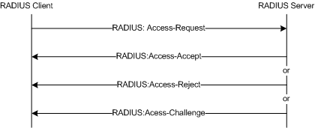
RADIUS Authentication and Authorization Flow

Slide 30
Contd..
This request includes access credentials, typically in the form of username and password or security certificate provided by the user. Additionally, the request may contain other information which the NAS knows about the user, such as its network address or phone number, and information regarding the user's physical point of attachment to the NAS.
The RADIUS server checks that the information is correct using authentication schemes like PAP, CHAP or EAP. The user's proof of identification is verified, along with, optionally, other information related to the request, such as the user's network address or phone number, account status and specific network service access privileges. Historically, RADIUS servers checked the user's information against a locally stored flat file database. Modern RADIUS servers can do this, or can refer to external sources - commonly SQL, Kerberos, LDAP, or Active Directory servers - to verify the user's credentials.

Slide 31
The RADIUS server then returns one of three responses to the NAS : 1) Access Reject, 2) Access Challenge or 3) Access Accept.
Access Reject - The user is unconditionally denied access to all requested network resources. Reasons may include failure to provide proof of identification or an unknown or inactive user account.
Access Challenge - Requests additional information from the user such as a secondary password, PIN, token or card. Access Challenge is also used in more complex authentication dialogs where a secure tunnel is established between the user machine and the Radius Server in a way that the access credentials are hidden from the NAS.
Access Accept - The user is granted access. Once the user is authenticated, the RADIUS server will often check that the user is authorised to use the network service requested. A given user may be allowed to use a company's wireless network, but not its VPN service, for example. Again, this information may be stored locally on the RADIUS server, or may be looked up in an external source like LDAP or Active Directory.

Slide 32
Accounting
When network access is granted to the user by the NAS, an Accounting Start (a RADIUS Accounting Request packet containing a Acct-Status-Type attribute with the value "start") is sent by the NAS to the RADIUS server to signal the start of the user's network access. "Start" records typically contain the user's identification, network address, point of attachment and a unique session identifier.^{[5]}
Periodically, Interim Update records (a RADIUS Accounting Request packet containing a Acct-Status-Type attribute with the value "interim-update") may be sent by the NAS to the RADIUS server, to update it on the status of an active session. "Interim" records typically convey the current session duration and information on current data usage.
Finally, when the user's network access is closed, the NAS issues a final Accounting Stop record (a RADIUS Accounting Request packet containing a Acct-Status-Type attribute with the value "stop") to the RADIUS server, providing information on the final usage in terms of time, packets transferred, data transferred, reason for disconnect and other information related to the user's network access.
Typically, the client sends Accounting-Request packet until it receives a Accounting-Response acknowledgement, using some retry interval.
The primary purpose of this data is that the user can be billed accordingly; the data is also commonly used for statistical purposes and for general network monitoring.

Slide 33
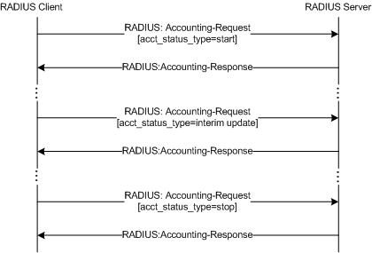
RADIUS Accounting Flow

Slide 34
Roaming
RADIUS is commonly used to facilitate roaming between ISPs, for example:
by companies which provide a single global set of credentials that are usable on many public networks;
by independent, but collaborating, institutions issuing their own credentials to their own users, that allow a visitor from one to another to be authenticated by their home institution, such as in Eduroam.
RADIUS facilitates this by the use of realms, which identify where the RADIUS server should forward the AAA requests for processing.

Slide 35
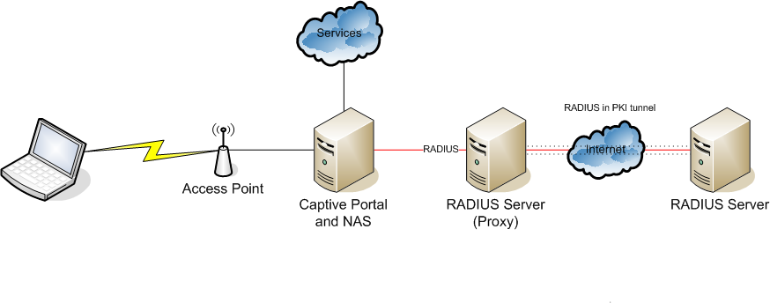
Roaming using a proxy RADIUS AAA server.
Roaming using a proxy RADIUS AAA server.

Slide 36
Realms
A realm is commonly appended to a user's user name and delimited with an '@' sign, resembling an email address domain name. This is known as postfix notation for the realm. Another common usage is prefix notation, which involves prepending the realm to the username and using '\' as a delimiter. Modern RADIUS servers allow any character to be used as a realm delimiter, although in practice '@' and '\' are usually used.
Realms can also be compounded using both prefix and postfix notation, to allow for complicated roaming scenarios; for example, somedomain.com\username@anotherdomain.com could be a valid username with two realms.
Although realms often resemble email domains, it is important to note that realms are in fact arbitrary text and need not contain real domain names.

